Slide 1


Modelica-Based Dynamic Modeling of a Solar-Powered Ground Source Heat Pump System: A Preliminary Case Study
Zheng O’Neill, PhD, PE
The University of Alabama, Tuscaloosa, AL
October 9th 2018
The American Modelica Conference 2018, Oct. 9-10, 2018 in Cambridge, MA

Slide 2
Outline
Introduction
Test rig
Modeling
Preliminary Results
Conclusions and Future work

Slide 3
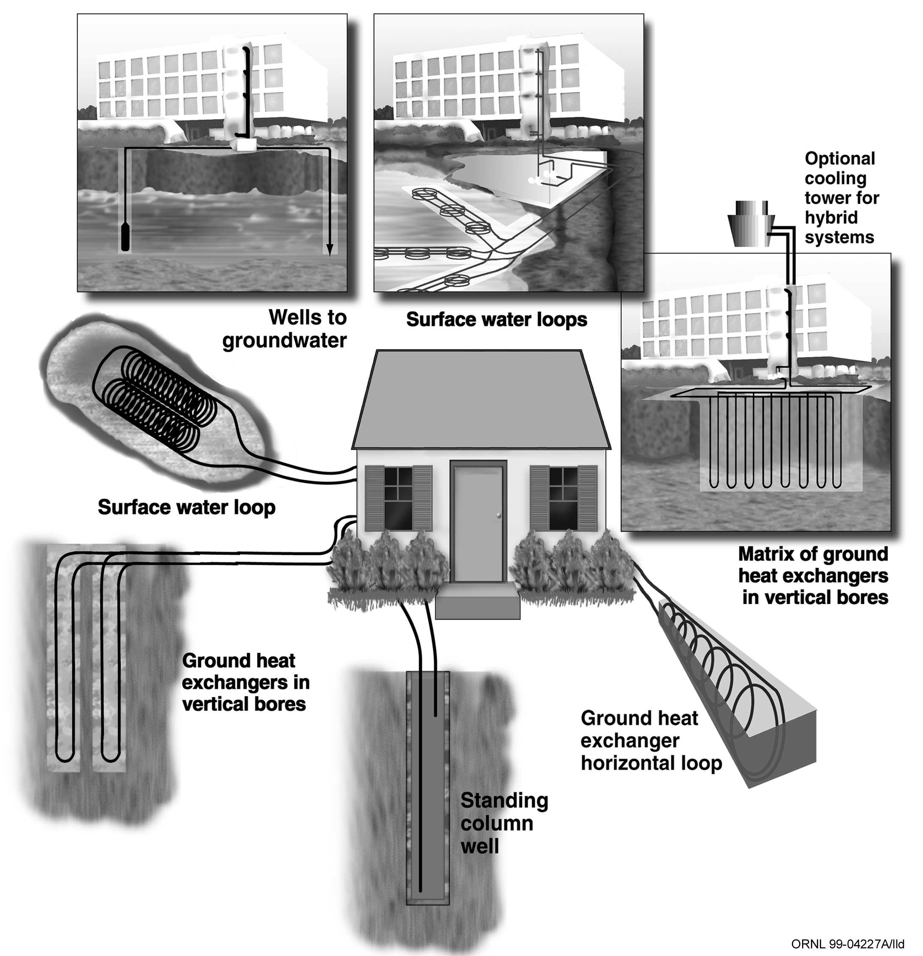
Ground Source Heat Pump (GSHP) System
Most efficient system in the market
Ground Coupled
Surface Water
Ground Water
Close-loop
Open-loop

Slide 4
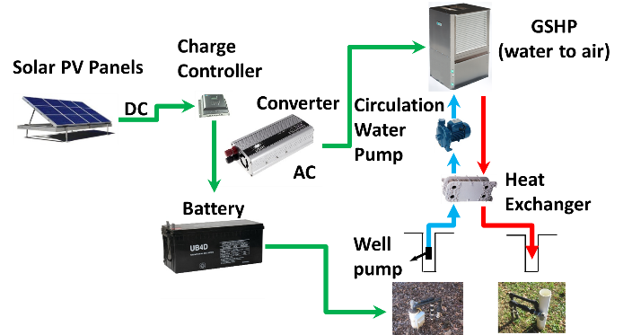
Solar-Powered GSHP
Heat Pump
¾ tons
Geothermal System
Two wells of 60 feet
Close-loop
Solar Panels
800 Watts for heat pump
320 Watts for well pump
Two battery banks
Heat pump
Well pump

Slide 5
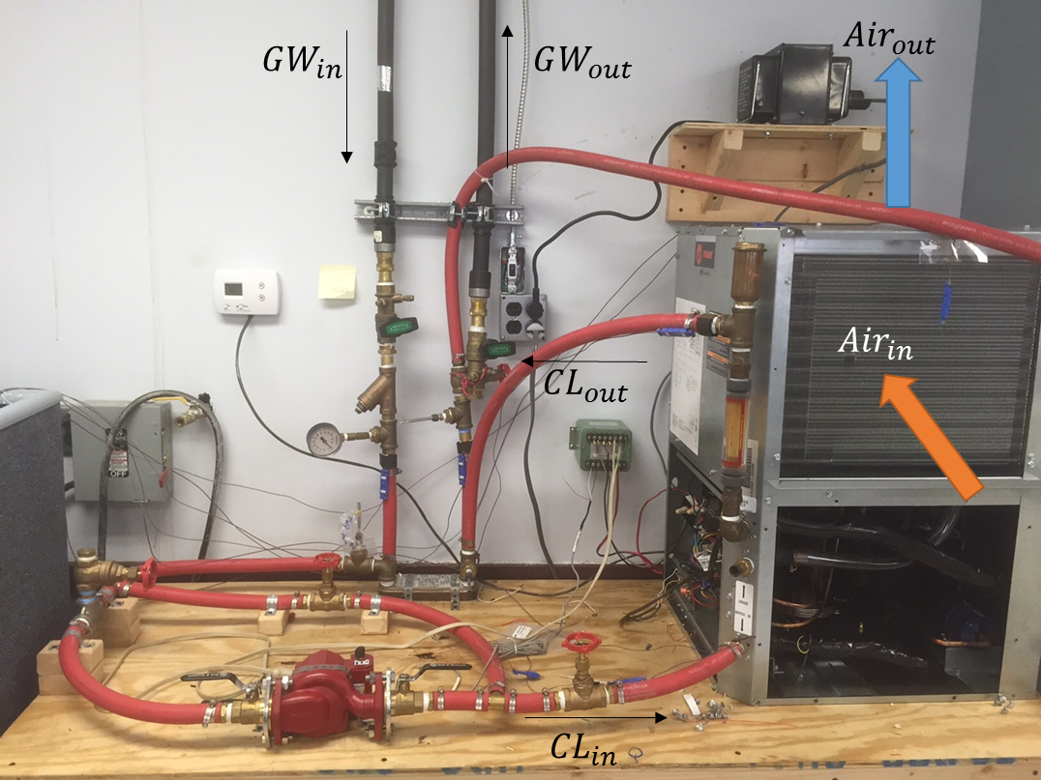
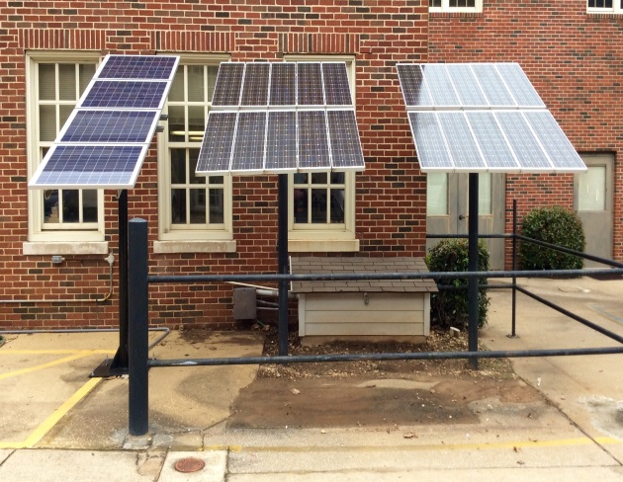
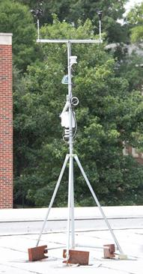
Test Rig
GSHP
Solar Panels
Weather Station

Slide 6
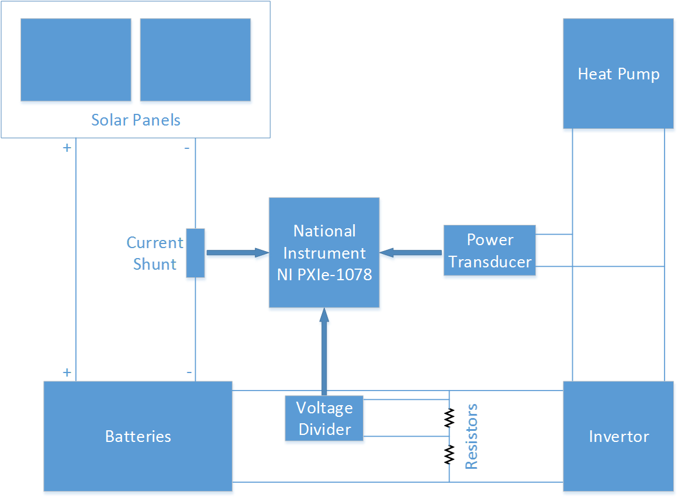
Measurements
Position | Sensor
Ground Water Inlet (from the well) | Temperature Sensor 1
Ground Water Outlet (to the well) | Temperature Sensor 2
Circulate Water Inlet (to the GSHP) | Temperature Sensor 3
Circulate Water Outlet (from the GSHP) | Temperature Sensor 4
Air Intake (to the GSHP) | Temperature Sensor 5
Air Outlet (from the GSHP) | Temperature Sensor 6
Power Sensor (GSHP) | Power Transducer
Solar Panel Input Voltage | Voltage Divider
Solar Panel Input Current | Current Shunt
Power measurements
Solar Power inputs
Power consumption of the heat pump

Slide 7
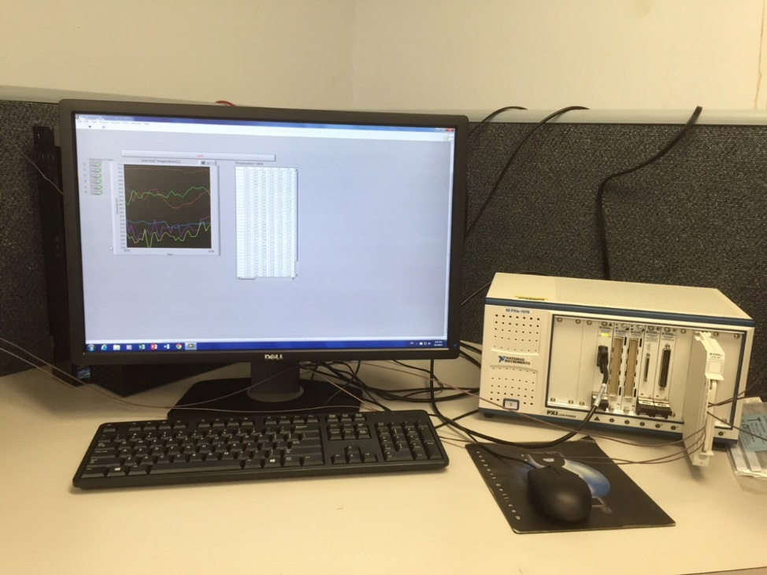
Data Acquisition System
Specifications (National Instrument)
T-type thermocouple input module has 32 channels with 0.3 ˚C accuracy
Voltage module has two analogy outputs, 16-bit resolution and a range of ± 10 Volt
Sampling rate is once per second

Slide 8
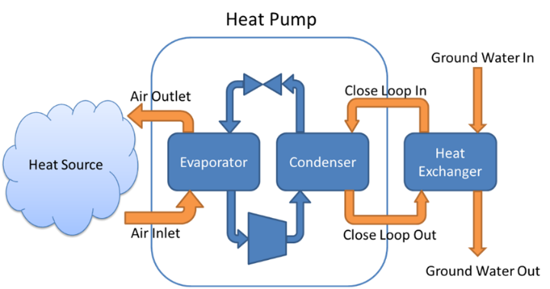
GSHP – The Focus of This Paper
A rotary type compressor, rated cooling capacity is 2,638 Watts.
R-410a as the refrigerant
The refrigerant pressure is 3,103 kPa at the condenser side, and 1,724 kPa at the evaporator side.
Air side, the maximum external static pressure is 17,436 Pa.
The rated operating voltage is 208 Volts, and the short-circuit current rating is 5 kA at 600V.

Slide 9
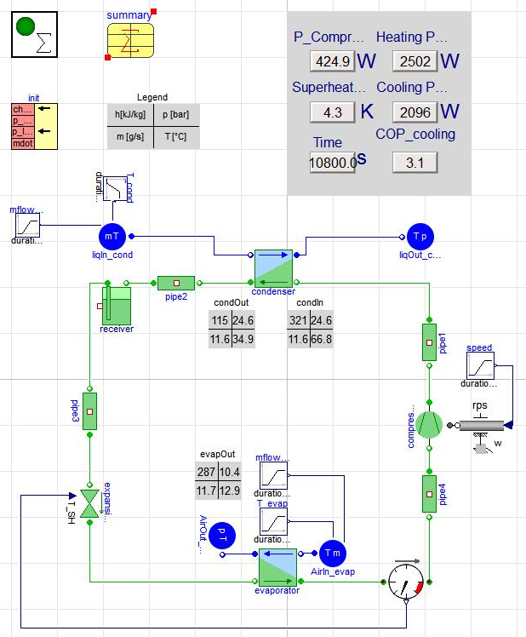
Modelcia Modeling
Component | Model Descriptions
Condenser | Heat exchanger; Counterflow; R410a as working fluid; Water as liquid
Evaporator | Heat exchanger; Counterflow; R410a as working fluid;Air as liquid
Expansion Valve | Simplified Thermal Expansion Valve model, based on compressible flow valve in IEC 534/ISA S.75 standards
Compressor | Fixed displacement compressor with speed and pressure ratio dependency
Liquid Source | Modelon.Media.PreDefined.Liquids.IncompressibleWater is the Medium on condenser side; VaporCycle.Media.Air.MoistAirNoFreezing is the medium on evaporator side.
Liquid Sink | Modelon.Media.PreDefined.Liquids.IncompressibleWater is the Medium on condenser side; VaporCycle.Media.Air.MoistAirNoFreezing is the medium on evaporator side.
Dymola (version 2017 FD01)
Modelica library-Vapor Cycle Library (Modelon, 2018)

Slide 10
Modeling Assumptions
Constant Temperature for the heat sink
The water inlet temperature on the condenser side
The heat source (i.e., the air inlet temperature on the evaporator side).
Modelica model didn’t include the blower fan
A constant fan power consumption was assumed to get the total power consumption of the GHSP unit from the model.

Slide 11
Results – Testing and Modeling Conditions
The comparisons between the actual measurements and simulation results were based on a three-hour testing.
The GSHP system was operating in a cooling mode.
The environment temperature was controlled at 22 °C, while the discharge air temperature set point of the GSHP system was 16 °C. The GSHP system maintained in operation during the three-hour test.
The flow rate of circulation groundwater was measured at 0.454 m³/hr, while the air flow rate was maintained at 0.134 m³/sec.
The measured temperature values include inlet water temperature at the condenser side and inlet air temperature at the evaporators side was used as the inputs to the Modelica model.
Other settings were referred to the GHSP manufacturer’s specifications.

Slide 12
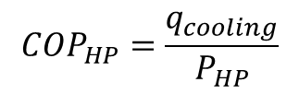
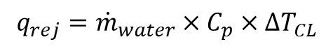
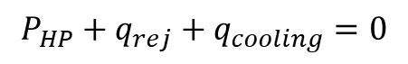
Results- Comparisons (Model vs. Experiment)
Category | CVRMSE* | NMBE*
Power Consumption | 12.92% | 12.86%
Cooling Capacity | 12.29% | 7.42%
COP | 19.69% | 17.99%
$$P_{HP}+q_{rej}+q_{cooling}=0$$
$$q_{rej}={\dot{m}}_{water}×C_{p}×∆T_{CL}$$
$${COP}_{HP}=\frac{q_{cooling}}{P_{HP}}$$
*CVRMSE is the coefficient of variation of the root mean square error
* NMBE is the normalized mean bias error

Slide 13
Conclusions
Preliminary results from the Modelica-based modeling of a GSHP unit. The model predictions were compared with measurements from the test rig. The current Modelica-based model can simulate the performances of the GSHP unit. The output trends for the Modelica simulation match with those from measurements well.

Slide 14
Ongoing and Future Work-1
Modelica model of the supply side of solar panels, which will use the actual weather data as the input to estimate the power generation of the solar panels.
On the groundwater side, a Modelica model of the groundwater well will be developed so the impact of ground (e.g., thermal conductivity and hydraulic conductivity) can be further analyzed.
A comprehensive system model of solar-powered ground source heat pump system will be validated using the measurement from the test rig. Testing data will be collected for a longer period for both heating and cooling modes.
Dynamic inputs such as weather information, room air and groundwater temperature profiles will be used as inputs in the full scaled model to study the dynamic performance of the system.

Slide 15


Ongoing and Future Work-2
The dynamic system model will be used for the following applications:
Model-based control of the solar PV generation system and ground source heat pump system, and the combination of these systems for a better building to grid integration.
GSHP controller design using this dynamic model in the Hardware-in-the-Loop (HIL) testing.

Slide 16
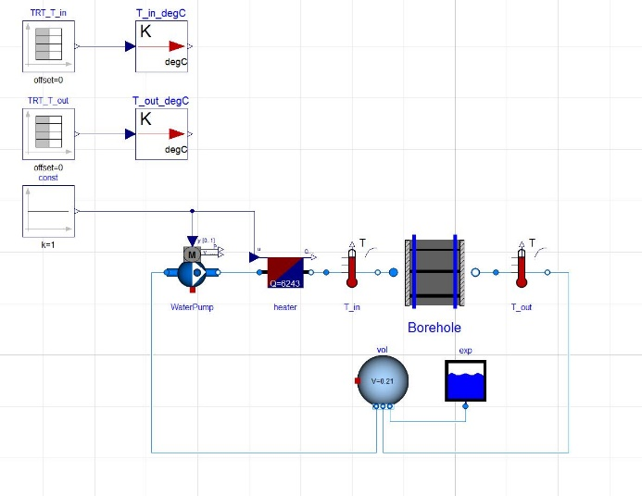
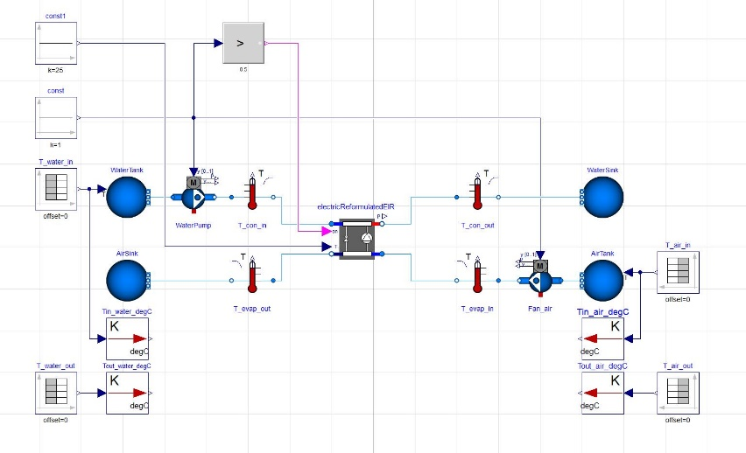
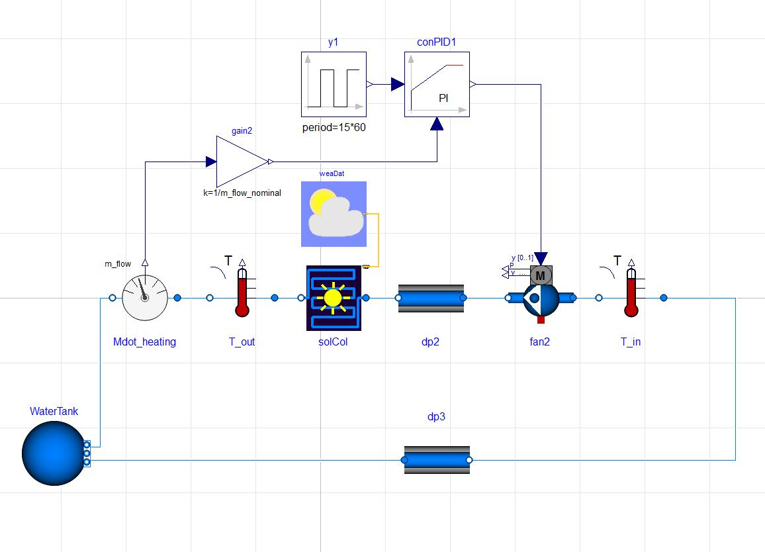
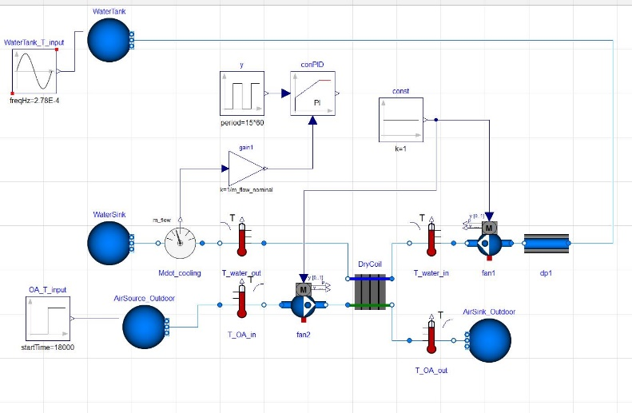
Ongoing and Future work-3
Modeling and validation of a residential hybrid GSHP system
Borehole model
Heat pump model
Solar PV model
Dry cooler model
Single Borehole
Heat pump
Solar PV
Dry cooler

Slide 17
Thank You! Questions and Discussions
Zheng O’Neill, PhD, PE
Department of Mechanical Engineering
Department of Civil, Construction and Environmental Engineering
The University of Alabama
Box 870276
Tuscaloosa, AL 35487-0276 USA
Ph: (205) 348-6982 | Fax: (205) 348-6419
Email: ZONeill@eng.ua.edu
http://hvac.ua.edu/
Qian, D. , and Z.D. O’Neill. 2018. Modelica-Based Dynamic Modeling of a Solar-Powered Ground Source Heat Pump System: A Preliminary Case Study. American Modelica Conference 2018. Cambridge, MA, October 9-10, 2018.

